Slide 1
INTRODUCTION TO TIME SERIES ANALYSIS USING PYTHON

Slide 2
Application Areas
Industry
Model/Predict
Based on Information such as:
Purpose
Finance
Price of a Stock
Recent price movement of the stock
Forecasting
Economics
Inflation Rates
Trend and seasonality in inflation rates
Forecasting
Retail /FMCG
Monthly Sales
Location, marketing expenses on TV, print and online media
Predictive and Optimization

Slide 3
Case Study
Background
Objective
Available Information
Annual Sales for a specific company from year 1961 to 2017
To plot a time series object
Variables: Year, sales(in 10’s GBP)
Number of cases: 57

Slide 4
Data Snapshot
turnover_annual data
Variables
Observations on Discrete Time Scale
Columns | Description | Type | Measurement | Possible values
Year | Financial Year | Numeric | - | -
sales | sales(in 10’s GBP) | Numeric | In British Pound | Positive values

Slide 5
Time Series in Python
# Import turnover_annual Data
import pandas as pd salesdata = pd.read_csv('turnover_annual.csv')
# Creating a Time Series Object
rng = pd.date_range('01-01-1961','31-12-2017',freq='Y') s = salesdata.sales.values salesseries = pd.Series(s, rng)
date_range() creates pandas date object.
When the time series has seasonal components, argument freq = can be included. It denotes number of observations per unit of time. Eg. If data is quarterly: freq = ‘Q’, if data is monthly: freq = ‘M’.
pd.Series() combines time series variable object “s” and date object “rng”.
The new object salesseries will be used for further analysis.

Slide 6
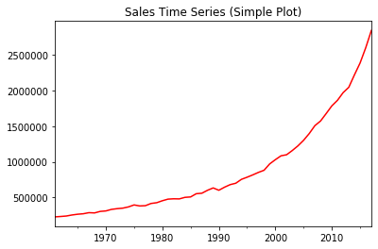
Plotting Time Series in Python
# Plotting a Time Series Object
salesseries.plot(color='red', title ="Sales Time Series (Simple Plot)")
plot() generates a simple line chart.
# Output
Interpretation :
The time-series clearly shows upward trend.

Slide 7
Subsetting Time Series in Python
Large volumes of data are required for most real world analytics, time series is no exception.
Subsetting is an important tool as it facilitates partitioning the data within Python for micro-level specific analysis.
# Subsetting a Time Series Object
salesseries2 = salesseries.loc['1990-12-31':'2016-12-31']
loc[ ] is a generic function which extracts the subset of the object x observed between the times specified within the range.
*
In Pandas we can directly subset the time series object using loc[] function

Slide 8
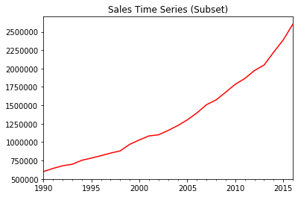
Subsetting Time Series in Python
salesseries2.plot(color='red', title ="Sales Time Series (Subset)")
# Output
Plot from 1990 to 2016 shows increasing trend

Slide 9
What is Stationarity of Time Series ?
Time series process is called Stationary if statistical properties of the process remain unchanged over time.
If Y_{t} is a stationary time series where t=1,2,3,…
then,
E(Y_{t}) = μ_{t} =μ (constant)
Var(Y_{t}) = σ_{t}² = σ² (constant)
cov(Y_{t},Y_{t+s}) depends only on s (lag), and is independent of t (time)

Slide 10
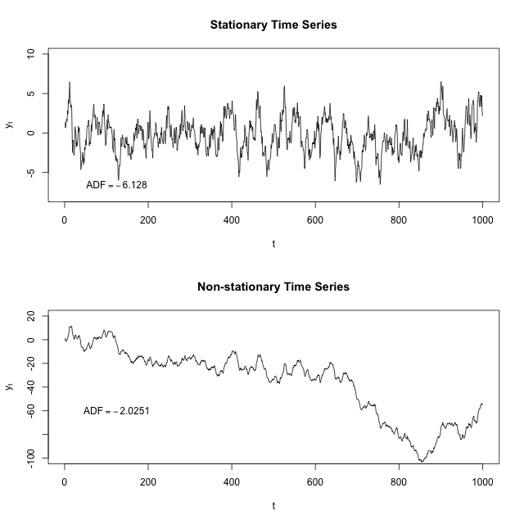
Stationary vs. Non-Stationary Time Series
Fig. 1: Stationary Time Series
Fig. 2: Non-Stationary Time Series
Interpretation :
A stationary time series has a constant long term mean and variance.
The first diagram shows a stationary time series whereas the second shows a non-stationary series.

Slide 11
Importance of Stationary Time Series
Calibration (estimation of model parameters using historical data) is an important concept in the forecasting of time series values.
In the calibration of time series models we need a stationary time series.
With a non stationary time series we get into spurious regression which badly affects forecasting.

Slide 12
How to Make a Non Stationary Time Series Stationary?
Two Methods for Making Time Series Stationary
Differencing
De-trending
Y_{t} = Y_{t-1} + U_{t} ;t=1,2,3…..
Y_{t} = β₁ + β₂t + U_{t} ;t=1,2,3…..
U_{t} is a random series with Constant mean μ, Constant variance σ² , and is serially uncorrelated i.e (Ut is stationary).
Hence, Y_{t} is differenced:
U_{t} is a stationary with zero mean and constant variance σ² . When Trend element (β₁ + β₂t) is subtracted , the result is a stationary process :
Y_{t} – Y_{t-1} = ∆Y= U_{t}
Y_{t} – (β₁ + β₂t) = U_{t}
Differencing can be well applied in case of stochastic time series
De-trending is useful when trend is deterministic

Slide 13
Identifying Stationary Time Series & Concept of Autocorrelation
Approaches
Statistical Test
Graphical
Correlogram
Dickey Fuller Test

Slide 14
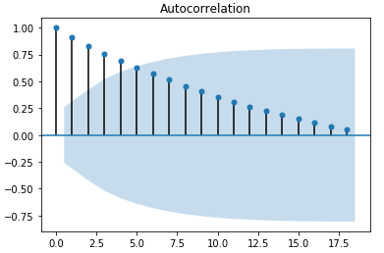
Checking Stationarity – Correlogram
# ACF Plot
import matplotlib.pyplot as plt from statsmodels.graphics.tsaplots import plot_acf, plot_pacf plot_acf(salesseries)
plot_acf() returns an ACF (Auto Correlation Function) plot.
# Output
Interpretation :
We can observe that there is a very slow decay which is a sign of Non-stationarity.

Slide 15
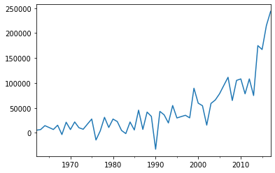
Plot of 1st Order Differenced Time Series
# Creating and Plotting a Difference Series
from statsmodels.tsa.statespace.tools import diff salesdiff = diff(salesseries) salesdiff.plot()
diff() gives 1st order differences
plot function gives line chart for differenced series
# Output
Interpretation :
Even after first order differencing, the series looks non-stationary.

Slide 16
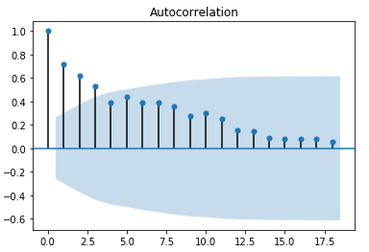
Correlogram for 1st Order Differenced Time Series
# ACF Plot
plot_acf(salesdiff)
# Output
Interpretation :
ACF plot shows slow decay
Stationarity is not achieved with first difference.

Slide 17
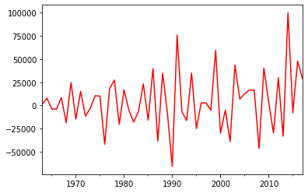
Plot of 2nd Order Differenced Time Series
#Creating and Plotting 2nd Difference Series
salesdiff2 = diff(salesdiff) salesdiff2.plot(color='red')
# Output
Interpretation :
After 2nd order differencing, the series looks stationary.

Slide 18
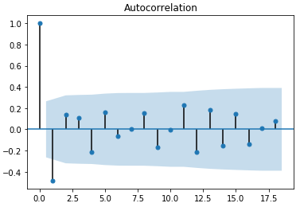
Correlogram for 2nd Order Differenced Time Series
# ACF Plot
plot_acf(salesdiff2)
# Output
Interpretation :
Stationarity is achieved with 2nd order difference.

Slide 19
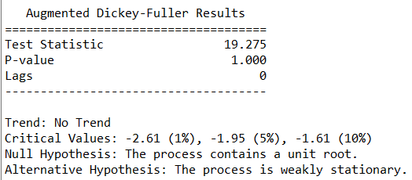
Dickey Fuller Test
# Install “arch”
ADF() performs a Dickey Fuller unit root test on time series data.
lags= allows to mention the number of lags to use in the ADF regression. We have used zero.
trend=‘nc’ specifies no trend and constant in regression
pip install arch
# Import “ADF” from library “arch”
from arch.unitroot import ADF adf = ADF(salesseries,lags=0,trend='nc') adf.summary()
# Output
Interpretation :
Time series is non-stationary as value of test statistic is greater than 5% critical value.

Slide 20
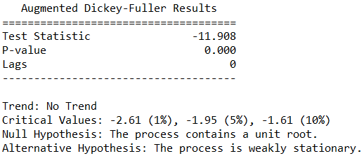
Dickey Fuller Test
# Checking stationarity for series with difference of order 2
adf = ADF(salesdiff2,lags=0,trend='n') adf.summary()
# Output
Interpretation :
Time series is stationary as value of test statistic is less than 5% critical value.

Slide 21
THANK YOU!!

